Slide 1


Mary Glantz
April 29, 2025

Slide 2

Outline
Executive Summary
Introduction
Methodology
Results
Conclusion
Appendix

Slide 3
Executive Summary
I gathered data from SpaceX using the SpaceX api and data from Wikipedia through web scraping. I then cleaned the data, retaining necessary columns to predict whether a booster rocket landed safely for reuse.
Using SQL, Pandas, and MatplotLib, I explored the data through statistics and visualization to suggest further paths for analysis. I used Plotly and Dash to create interactive visualizations for deeper understanding.
Using that data, I was able to determine several of the key factors, including launch site, booster version, and payload weight, that determined a successful launch/return.
Finally, I conducted predictive analysis using logistic regression, decision tree, support vector machine, and k-nearest neighbors models to determine the likelihood of a successful launch/return. With the data above, most models had 94% accuracy.

Slide 4
Introduction
SpaceX is able to charge lower prices than competitors because it often reuses booster rockets. Using SpaceX data, I was able to determine how much each launch costs by determining how often SpaceX was able to reuse those rockets. In practice, this means how often SpaceX is able to successfully land those boosters. Using exploratory data analysis, I could identify the key factors that appeared to determine whether or not a launch/return was successful. I think built and trained machine learning models that could predict whether or not a launch/return would be successful.
Key questions:
What does a SpaceX rocket launch cost
Will a Falcon 9 rocket land successfully

Slide 5

Section 1

Slide 6
Methodology
Executive Summary
Data collection methodology:
I gathered data from SpaceX using their API and from Wikipedia using Beautiful Soup
Perform data wrangling
I checked the data for missing values and calculated and created a column for the target variable---success or failure of launch/return
Perform exploratory data analysis (EDA) using visualization and SQL
Perform interactive visual analytics using Folium and Plotly Dash
Perform predictive analysis using classification models
Using grid search cross validation, I built and compared four classification models: logistic regression, support vector machine, decision tree, and k-nearest neighbors

Slide 7
Data Collection
Step 1: Gathered structured data from the SpaceX API
📥
Step 2: Used BeautifulSoup to scrape supplementary launch information from Wikipedia
🌐
Step 3: Cleaned and merged the datasets into a unified dataframe for analysis.
🛠️

Slide 8
Data Collection – SpaceX API
https://github.com/MEGlantz/spaceXdataProject/blob/main/jupyter-labs-spacex-data-collection-api.ipynb
General Process
Adding Columns
Data Collection via SpaceX API
Import requests and call SpaceX REST API (/launches) using requests.get()
Receive JSON response (structured launch data)
Use json_normalize() to flatten nested JSON fields
Create pandas DataFrame from cleaned JSON
Load launch data from SpaceX api: https://api.spacexdata.com/v4/launches/past and create dataset
Use the rocket column from the dataset to call the API and append the data to the dataset
Use the launchpad column to call the API and append the data to the dataset
Use the payloads column to call the API and append the data to the dataset
Use the cores column to call the API and append the data to the dataset

Slide 9
Data Collection - Scraping
https://github.com/MEGlantz/spaceXdataProject/blob/main/jupyter-labs-webscraping.ipynb
Scraped the web to collect Falcon 9 historical launch records from a Wikipedia page titled `List of Falcon 9 and Falcon Heavy launches`
This supplemented the data from the SpaceX api
performed an HTTP GET method to request the Falcon9 Launch HTML page as an HTTP response
Created a `BeautifulSoup` object from the HTML `response`
collected all relevant column names from the HTML table header
Created a data frame by parsing the launch HTML tables

Slide 10
https://github.com/MEGlantz/spaceXdataProject/blob/main/labs-jupyter-spacex-Data%20wrangling.ipynb
Data Wrangling
Explored the data using Pandas’ tools.
To create a target label for supervised model training, made a list of all landing outcomes that meant “failure” and assigned them a 0. Assigned successful outcomes a 1. Converted that list to a new column: “Class”
Explored the data types and counts in each column
Calculated the number of launches on each site
Calculated the number and occurrence of each orbit
Calculated the number and occurrence of mission outcome of the orbits
Created a landing outcome label from Outcome column

Slide 11
https://github.com/MEGlantz/spaceXdataProject/blob/main/edadataviz.ipynb
EDA with Data Visualization
Seaborn Cat Plots:
Flight Number vs Payload Mass
Flight Number vs Launch Site
Payload Mass vs Launch Site
Flight Number vs Orbit Type
Payload Mass vs Orbit Type
Bar Chart:
Success Rate by Orbit Type
Line Chart:
Success Rate over Time
Shows the relationship between the two variables to help identify what might affect the flight outcome.
Shows if there is a relationship between orbit type and flight outcome.
Shows if flight outcome changes over time.

Slide 12
EDA with SQL
Display the names of the unique launch sites in the space mission
Display 5 records where launch sites begin with the string ‘CCA’
Display the total payload mass carried by boosters launched by NASA (CRS)
Display average payload mass carried by booster version F9 v1.1
List the date when the first successful landing outcome in ground pad was achieved
List the names of the boosters which have success in drone ship and have payload mass greater than 4000 but less than 6000
List the total number of successful and failure mission outcomes
List all the booster_versions that have carried the maximum payload mass
List the records which will display the month names, failure landing_outcomes in drone ship, booster versions, and launch_site for the months in the year 2015.
Rank the count of landing outcomes (such as Failure (drone ship) or Success (ground pad)) between the date 2010-06-04 and 2017-03-20, in descending order.
https://github.com/MEGlantz/spaceXdataProject/blob/main/jupyter-labs-eda-sql-coursera_sqllite.ipynb

Slide 13
Build an Interactive Map with Folium
Added circles for each launch site with markers to indicate which sites they are
Added marker clusters to show the number of successful and failed launches
Added lines and marker to indicate the distance between the launch site and the coast and the nearest railroad
https://github.com/MEGlantz/spaceXdataProject/blob/main/lab_jupyter_launch_site_location.ipynb

Slide 14
Build a Dashboard with Plotly Dash
Added a dropdown list to enable Launch Site selection
Added a pie chart to show the total successful launches count for all sites
If a specific launch site was selected, showed the Success vs. Failed counts for the site
Added a slider to select payload range
Added a scatter chart to show the correlation between payload and launch success
These plots and interactions allowed the user to view the effect payload had on launch success at different sites
https://github.com/MEGlantz/spaceXdataProject/blob/main/spacex-dash-app%20(3).py

Slide 15
Predictive Analysis (Classification)
Separated the target variable from the features
Standardized the feature dataset
Split the data into training and testing sets using SKLearn train_test_split
Conducted grid search cross validation using four different models: Logistic Regression, Support Vector Machine, Decision Tree, and K-Nearest Neighbors
Assessed the accuracy, precision, and recall of all four models using confusion matrices
https://github.com/MEGlantz/spaceXdataProject/blob/main/SpaceX_Machine%20Learning%20Prediction_Part_5.ipynb

Slide 16
Results
Exploratory data analysis results
Interactive analytics demo in screenshots
Predictive analysis results

Slide 17

Section 2

Slide 18
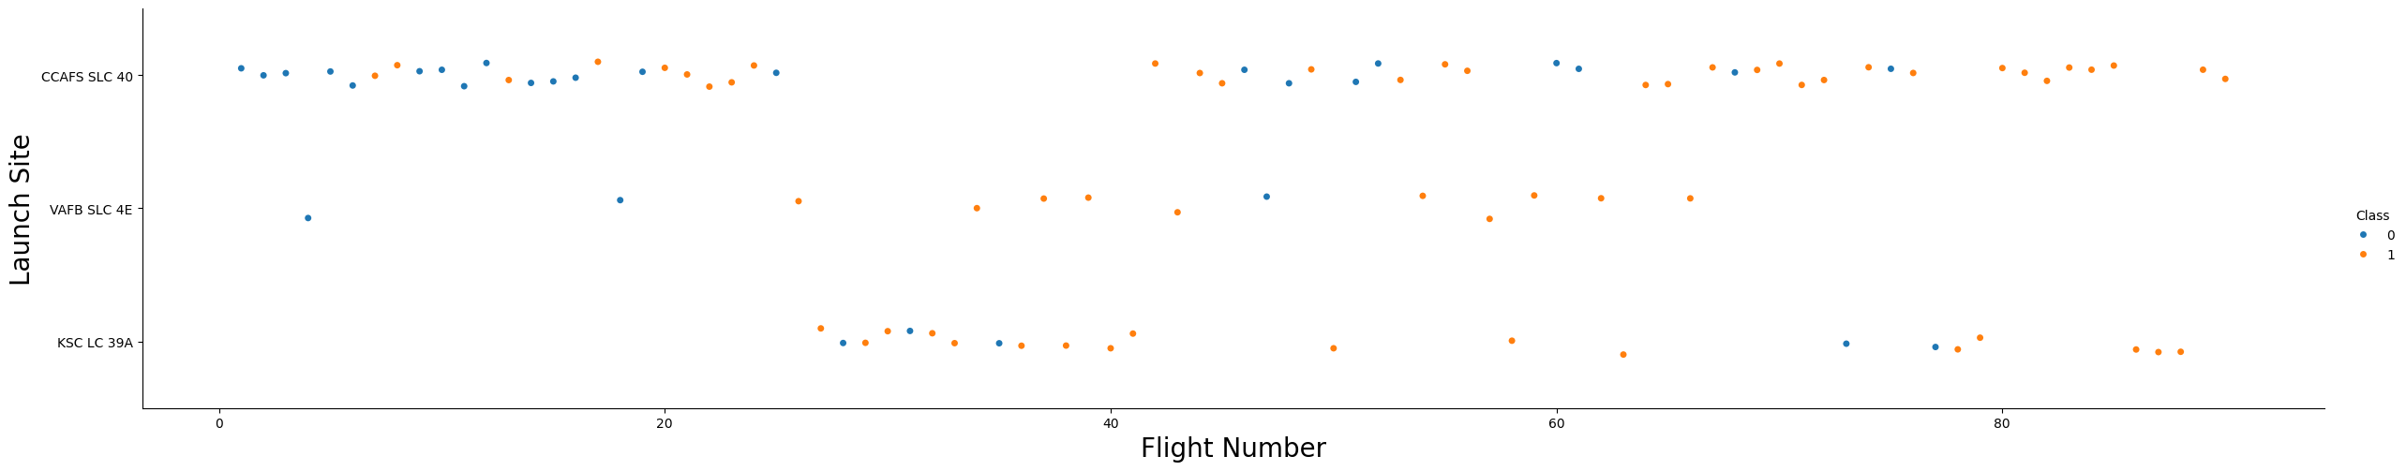
Flight Number vs. Launch Site
This Seaborn cat plot compares two categorical features: flight number and launch site.
The color indicates success (orange) or failure (blue).
All sites had more successes as the number of flights increased.

Slide 19
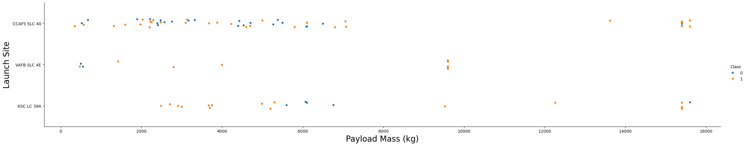
Payload vs. Launch Site
This cat plot shows the relationship between payload mass and launch site.
It also shows mission success (orange) or failure (blue) through the color of the dots.
CCAFS SLC 40 and KSC LC 39A launched the heaviest payloads.
Heavier payloads also tended to have fewer failures.

Slide 20
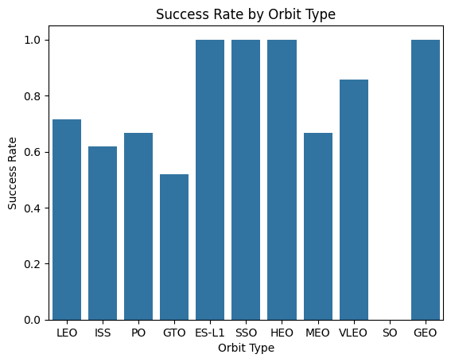
Success Rate vs. Orbit Type
This bar chart shows success rate by orbit type
The most successful orbit types (100%) are ES-L1, SSO, HEO, and GEO
SO has a 0% success rate

Slide 21
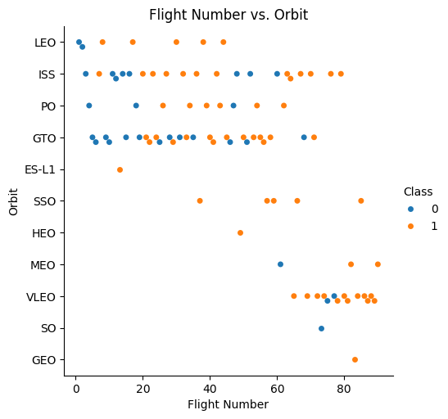
Flight Number vs. Orbit Type
This cat plot shows the relationship between flight number and orbit type.
The color shows success (orange) or failure (blue)
As SpaceX conducted more flights, it began to launch more to SSO, HEO, MEO, VLEO, SO, and GEO orbits
It has consistently launched to ISS, PO, and GTO orbits

Slide 22
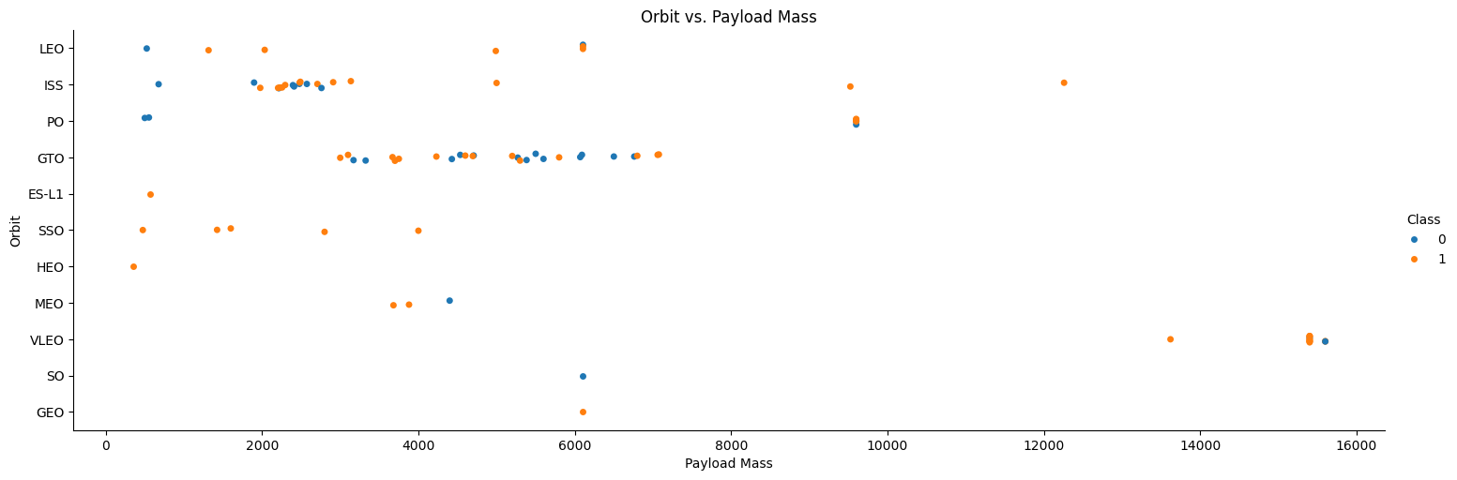
Payload vs. Orbit Type
This plot shows orbit type vs payload mass with color indicating success (orange) or failure (blue)
The heaviest payloads have been sent to VLEO or ISS, with the heaviest being a failure
Most payloads were sent to GTO or ISS and were within 2000 and 8000 kgs

Slide 23
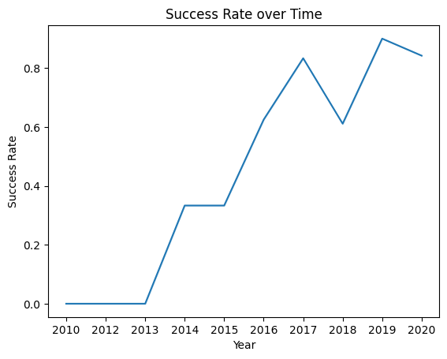
Launch Success Yearly Trend
This line plot shows the success rate over time
The success rate has trended upward over time
There was a slight dip (from 80% to 60%) in 2018

Slide 24
All Launch Site Names
This table shows the launch sites included in the SpaceX dataset
Launch Site
CCAFS LC-40
VAFB SLC-4E
KSC LC-39A
CCAFS SLC-40

Slide 25
Launch Site Names Begin with 'CCA'
This SQL query: %sql select "Launch_Site" from SPACEXTBL where "Launch_Site" like "CCA%" limit 5
Produced this result as expected:
It just shows five launch sites with names beginning with CCA
Launch Site
CCAFS LC-40
CCAFS LC-40
CCAFS LC-40
CCAFS LC-40
CCAFS LC-40

Slide 26
Total Payload Mass
The total payload carried by boosters from NASA:
This is the sum of all payloads in records where where customer = "NASA (CRS)"
sum("PAYLOAD_MASS__KG_")
45596

Slide 27
Average Payload Mass by F9 v1.1
The average payload mass carried by booster version F9 v1.1:
This is the result of this query: %sql select avg("PAYLOAD_MASS__KG_") from SPACEXTBL where "Booster_Version" = "F9 v1.1"
That filters the table to get entries where the booster version is F9 v1.1 and then calculates that average payload mass of those entries
avg("PAYLOAD_MASS__KG_")
2928.4

Slide 28
First Successful Ground Landing Date
The date of the first successful landing outcome on ground pad:
This is the result of this query: %sql select min(Date) from SPACEXTBL where "Landing_Outcome" = "Success (ground pad)"
It filters the data for only those that had a successful landing outcome on ground pad and then finds the minimum (earliest) date
min(Date)
2015-12-22

Slide 29
Successful Drone Ship Landing with Payload between 4000 and 6000
The names of boosters which have successfully landed on a drone ship and had a payload mass greater than 4000 but less than 6000
This is the result of this query: %sql select "Booster_Version" from SPACEXTBL where "Landing_Outcome" = "Success (drone ship)" and "PAYLOAD_MASS__KG_" > 4000 AND "PAYLOAD_MASS__KG_" < 6000
This filters the data by landing outcome and payload mass and returns the booster versions
Booster_Version
F9 FT B1022
F9 FT B1026
F9 FT B1021.2
F9 FT B1031.2

Slide 30
Total Number of Successful and Failure Mission Outcomes
The total number of successful and failure mission outcomes
This is the result of the following query: %sql select "Mission_Outcome", count(*) AS "Count" from SPACEXTBL group by "Mission_Outcome"
This counted each category in Mission_Outcome and returned a new column of Count for each Mission_Outcome
Mission_Outcome | Count
Failure (in flight) | 1
Success | 99
Success (payload status unclear) | 1

Slide 31
Boosters Carried Maximum Payload
Booster_Version
F9 B5 B1048.4
F9 B5 B1049.4
F9 B5 B1051.3
F9 B5 B1056.4
F9 B5 B1048.5
F9 B5 B1051.4
F9 B5 B1049.5
F9 B5 B1060.2
F9 B5 B1058.3
F9 B5 B1051.6
F9 B5 B1060.3
F9 B5 B1049.7
The names of the booster which have carried the maximum payload mass
This resulted from this query: %sql select "Booster_Version" from SPACEXTBL where "PAYLOAD_MASS__KG_" = (select max(PAYLOAD_MASS__KG_) from SPACEXTBL)
This identified the maximum payload mass, filtered the dataset to include only those with the maximum payload mass, and then selected the booster version from those results.

Slide 32
2015 Launch Records
The failed landing_outcomes in drone ship, their booster versions, and launch site names for months in the year 2015
This resulted from this query: %%sql select CASE substr(Date, 6, 2)…"Booster_Version", "Launch_Site" from SPACEXTBL where "Landing_Outcome" = "Failure (drone ship)” and substr(Date,0,5) ='2015’
This filtered by year and landing_outcome = failure(drone ship), then it selected the month, the booster version and launch site. I also converted the date number to name (in the ellipse)
Month | Booster_Version | Launch_Site
January | F9 v1.1 B1012 | CCAFS LC-40
April | F9 v1.1 B1015 | CCAFS LC-40

Slide 33
Rank Landing Outcomes Between 2010-06-04 and 2017-03-20
The count of landing outcomes between the date 2010-06-04 and 2017-03-20, in descending order
This resulted from this query:
%%sql select "Landing_Outcome", count(*) as "Count" from SPACEXTBL
where date > "2010-06-04" and date < "2017-03-20"
group by "Landing_Outcome” order by "Count" desc
This grouped the data by landing outcome, filtered by date, and then created a count column for each outcome
Landing_Outcome | Count
No attempt | 10
Success (drone ship) | 5
Failure (drone ship) | 5
Success (ground pad) | 3
Controlled (ocean) | 3
Uncontrolled (ocean) | 2
Precluded (drone ship) | 1
Failure (parachute) | 1

Slide 34

Section 3

Slide 35
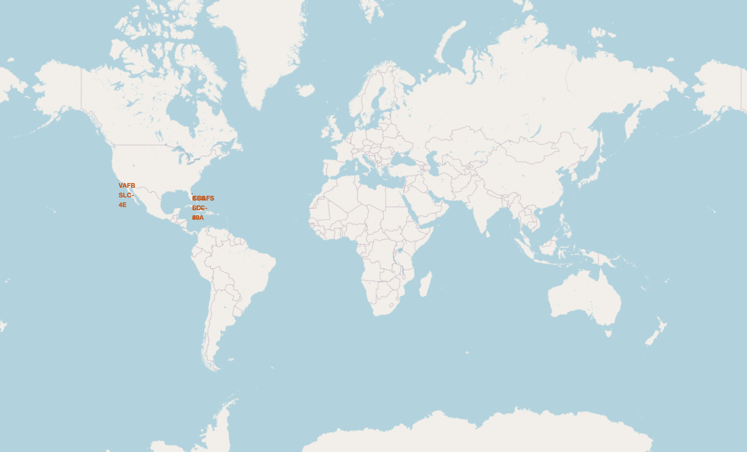
SpaceX Launch Sites
This global map shows the SpaceX launch sites in Florida and California

Slide 36
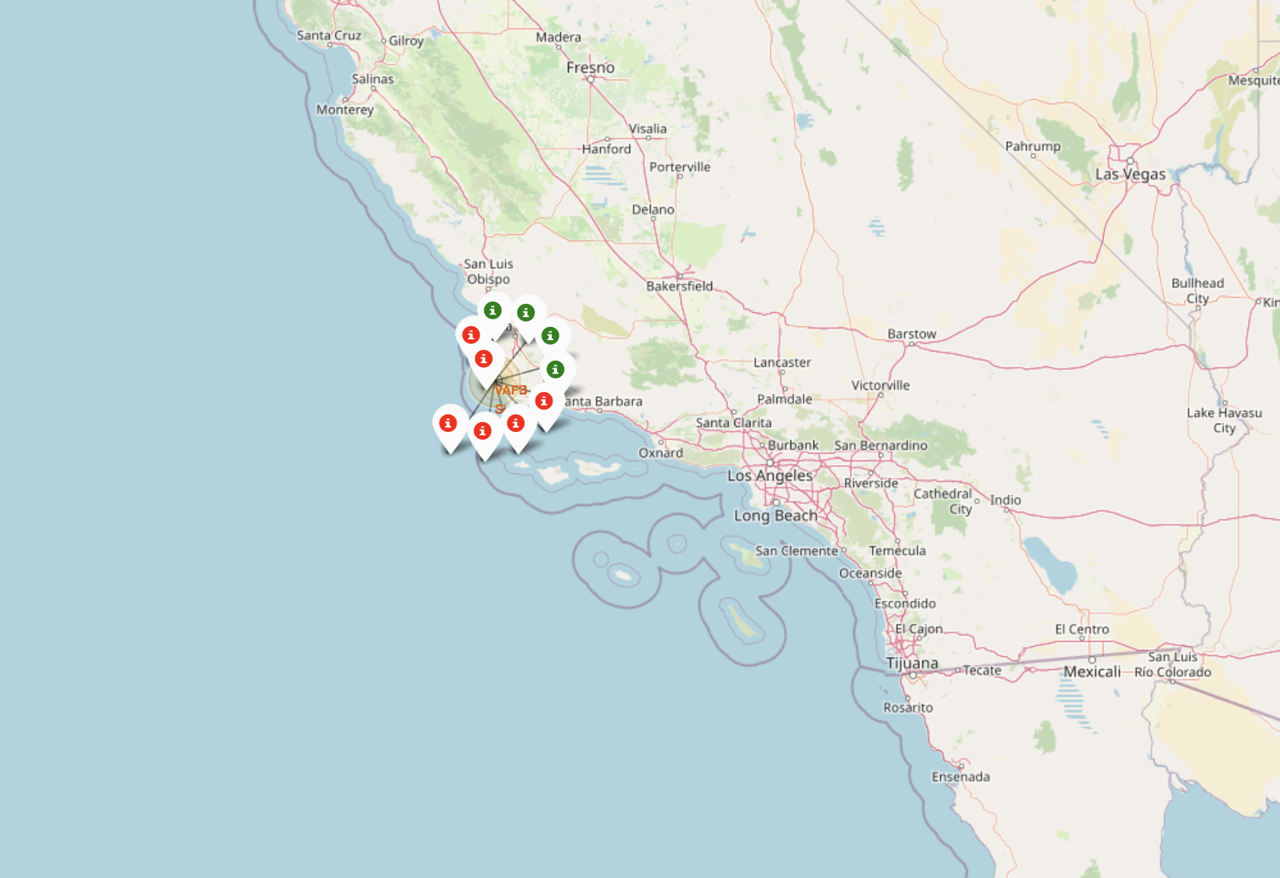
Launch Outcomes at VAFB
These markers show the outcome of flights at VAFB
The green indicate successful launches
The red indicate failed launches
There were more (6) failed than successful (4) launches

Slide 37
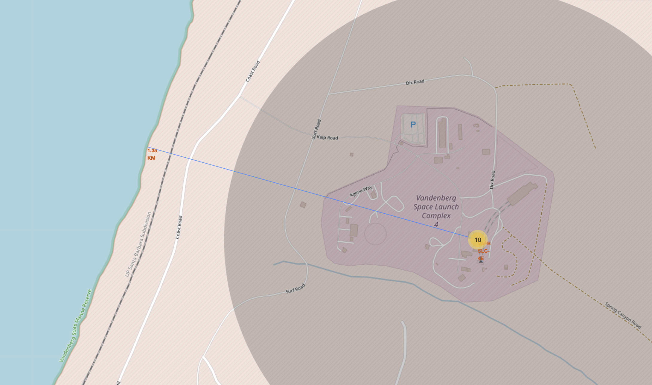
Launch Site Proximity to Coast
The blue line shows the distance from the VAFB launch site to the coast
The red marker indicates the distance is 1.35 km

Slide 38

Section 4

Slide 39
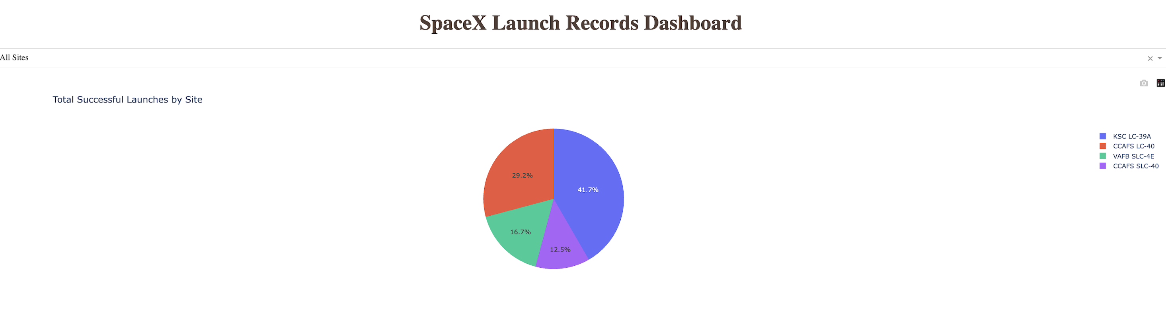
Successful Launches
This pie chart shows the percent of successful launches by launch site.
The most successful launches were at KSC LC-39A with 41.7% of all successful launches
The fewest successful launches were at CCAFS SLC-40 with only 12.5% of all successful launches

Slide 40
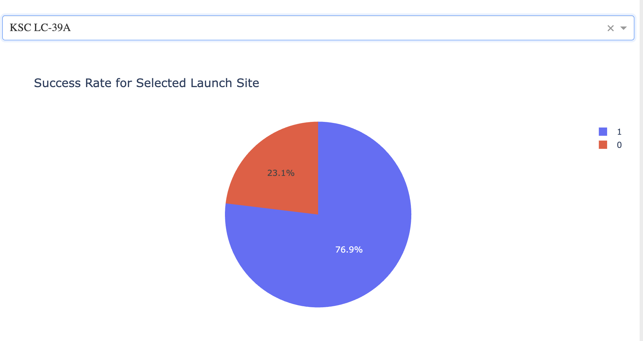
Success Rate for KSC LC-39A Launch Site
This pie chart shows the success rate for the site with the highest success rate: KSC LC-39A
At KSC LC-39A 76.9% of the launches were successful
23.1% of the launches were failures

Slide 41
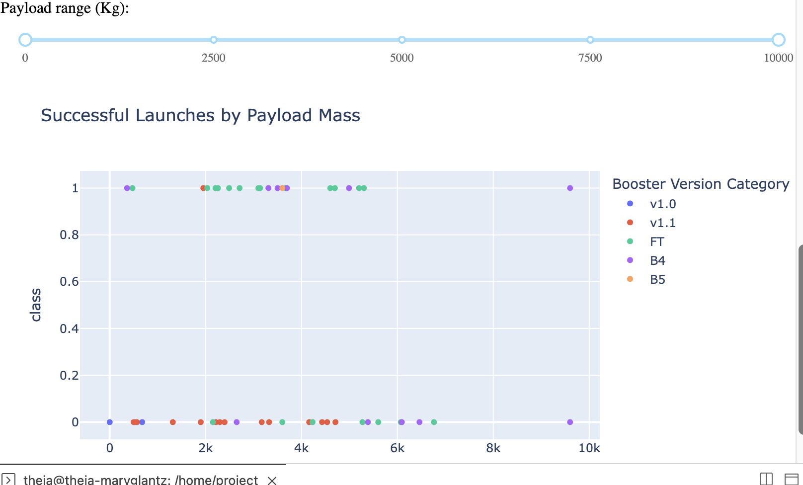
Successful Launches by Payload Mass
This interactive plot shows which booster had success or failure with which payload mass.
B4 was most successful (and least) with heavy payloads
FT was consistently most successful at the payload range 2000-4000 kg
V1.1 had the worst outcomes at all ranges

Slide 42

Section 5

Slide 43
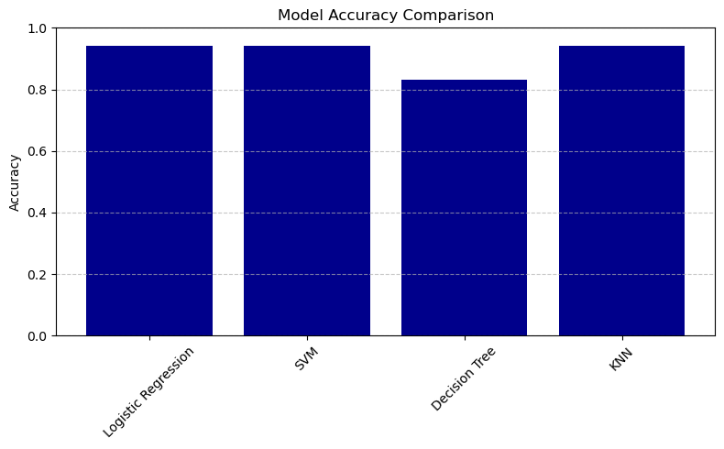
Classification Accuracy
Logistic Regression, SVM, and KNN achieved equal accuracy (94%) on the test data
The Decision Tree model achieved lower accuracy (83%) on the test data

Slide 44

Confusion Matrix
This is the confusion matrix for the logistic regression model
It is exactly the same as the matrices for SVM and KNN
5 negatives (did not land) were correctly predicted and none of the ones predicted to fail succeeded
12 successes were also correctly predicted, but one predicted success did fail
Logistic regression is easiest to explain, so this is the one I would use given the similar performance

Slide 45
Conclusions
The success or failure of SpaceX launches (and, thus, the cost) can be predicted using data science
Key features for predicting success or failure include type of booster used, launch site, payload mass, and type of orbit they are attempting to attain
This data is easily available both through SpaceX’s api and through internet sources
Because the data is small and well-structured, a variety of models perform well in predicting outcomes
The most successful models were logistic regression, support vector machine, and K-nearest neighbors
Logistic regression is a good choice because of its explainability

Slide 46
Appendix
For all notebooks, please see:
https://github.com/MEGlantz/spaceXdataProject

Slide 47


